Slide 1
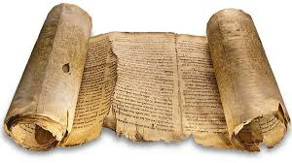
PRIMARY versus
SECONDARY
Sources
Notes:
To begin the narration, switch to Slide View and wiggle the mouse over Merlin’s name on the slide.
Please see the accompanying documentation for information about authoring scripts and the command syntax.
You can put any text that you want right here. As much as you want. And use whatever punctuation that you want (e.g. <!$^*&#($%^*). Cut and paste freely. But only as long as it is above the demarcation line below(you might want to think of it as the magic marker).
^*#{}#*^
SHOW merlin, merlin.acs, 83, 80
PLAY GetAttention
MOVE 40, 40
PLAY Confused
SAY Welcome to this presentation on what goes into analyzing primary source documents.
SAY Hi, I’m Merlin
SAY Dr. Sgarlata, your instructor for United States history, has asked me to do this narration for him.
PLAY RestPose
PLAY Explain
SAY In this course, you will be required to delve into some specific events in history and discover how people of the times viewed those events.
SLIDE 2 = SAY Let me tell you the purpose of historical inquiry.
.

Slide 2
Historians are like detectives:
Being a historian is very much like being a detective. Detectives look for clues to solve crimes or mysteries. The clues they use are called evidence. Historians use clues in the same way to solve mysteries of the past. The clues historians use are called sources.
Detectives look at crime scenes or mysteries and try to piece together a puzzle. Historians do the same, but look at evidence from people’s experiences from the past such as…..
What types of things does the evidence help us to understand?
Notes:
-clues about the way people lived
-how and why societies developed
-the motives that people had for doing the things they did
-How the world has changed.

Slide 3
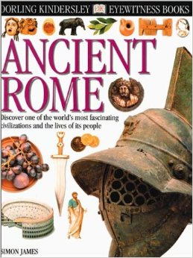
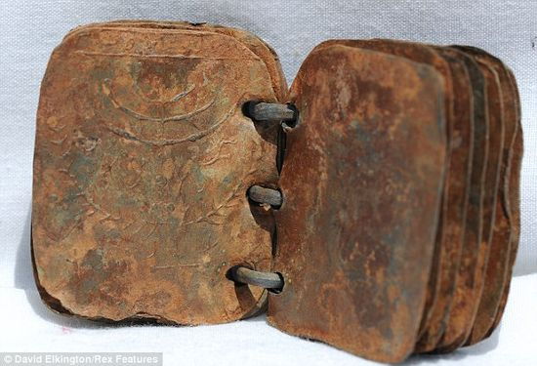
What is a source ?
Source-
1. The evidence that historians use from the past. Sources can be a person,
something used or made
by people, or a document

Slide 4
Let’s create a list of sources:

Slide 5
Let’s create a list of sources:
Newspapers
Photographs
Coins
Skeletons
Shipwrecks
Statues
Buildings
Pottery
Weapons
Witness accounts
Diary entries
Books
Mummies
Jewellery

Slide 6
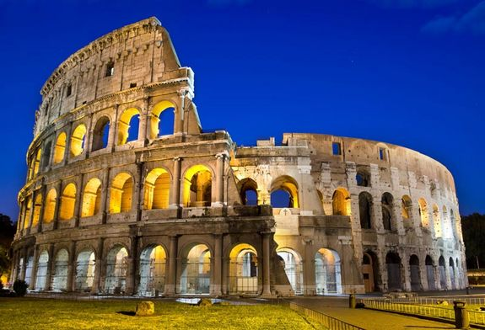
A Primary Source -
Created during the time period you are studying, or by someone who was present during the time. A first hand account.
What is a Primary Source?
Examples:
1. Diaries, speeches, letters
Original photos or artwork
Documents of original manuscripts
Audio and Video recordings
Artefacts
Can you think of an example?
Notes:
Ancient Egyptian statue
Photograph of a WW1 soldier
Aboriginal cave painting
Diary entry of someone who survived the sinking of the Titanic

Slide 7
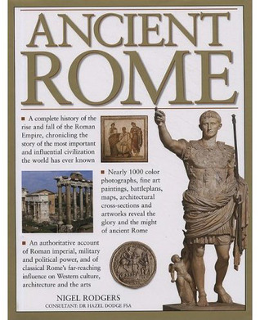
What are Secondary Sources?
Secondary Source-
Created after the time period you are studying.
These sources often use several primary sources to compile the information.
Biographies
Encyclopedias - including Wikipedia
History books
Textbooks
Film using re-enactments

Slide 8
THINK ABOUT IT
        ? ?
Secondary Source
Primary Source
Which column has primary sources in it and which has secondary?
Original Roman mosaics
An article critiquing the mosaics
Slave diary
Book about tourists in Pompeii
Poem by Seneca from 2nd Century Rome
A collection of poems
Essay on the Roman invasion of Britain
Painting of a play being performed
Biography of a Roman emperor
Notes:
^*#{}#*^
SHOW merlin, merlin.acs, 83, 80
PLAY RestPose
PLAY Explain
SAY History is an accumulation of facts and interpretations;
SAY bits and pieces of information that need to be put together for it to make sense.
PLAY GestureRight
SAY It is clear that all our information in regard to past events and conditions must be derived from evidence of some kind.
PLAY GestureUp
SAY This evidence is called the source.
SAY There are two kinds of sources that help us interpret history.
PLAY Explain
SAY Primary sources and secondary sources
SAY Some examples from various fields of study are shown here.
PLAY GestureRight
SAY In art you may be looking at paintings by Titian,
SAY the critique of that painting helps us understand the painting at least from the view of the person writing the critique.
SAY A book on the underground railroad through which slaves found freedom ,
SAY is greatly enhanced by those slaves who experienced it and wrote it down for posterity.
PLAY Explain
SAY As you can see there is a direct correlation between primary and secondary sources.
SLIDE 5= PLAY RestPose

Slide 9
Which is more useful?
Primary sources are useful because they contain first hand information about history
We need to be careful though…some witnesses from the past are unreliable.
Can you think of a primary source that might be unreliable?
Notes:
Bias, prejudice mean a strong inclination of the mind or a preconceived opinion about something or someone. A bias may be favorable or unfavorable: bias in favor of or against an idea.

Slide 10
Which is more useful?
Secondary sources are useful because they usually come from someone who has spent time investigating many primary sources and are giving us some conclusions about what might have occurred.
However, some secondary sources may be biased.
Can you think of a secondary source that could be biased?
Notes:
Bias, prejudice mean a strong inclination of the mind or a preconceived opinion about something or someone. A bias may be favorable or unfavorable: bias in favor of or against an idea.

Slide 11
Sources: Advantages and Disadvantages
Source | Examples | Advantages | Disadvantages
Primary
Secondary

Slide 12
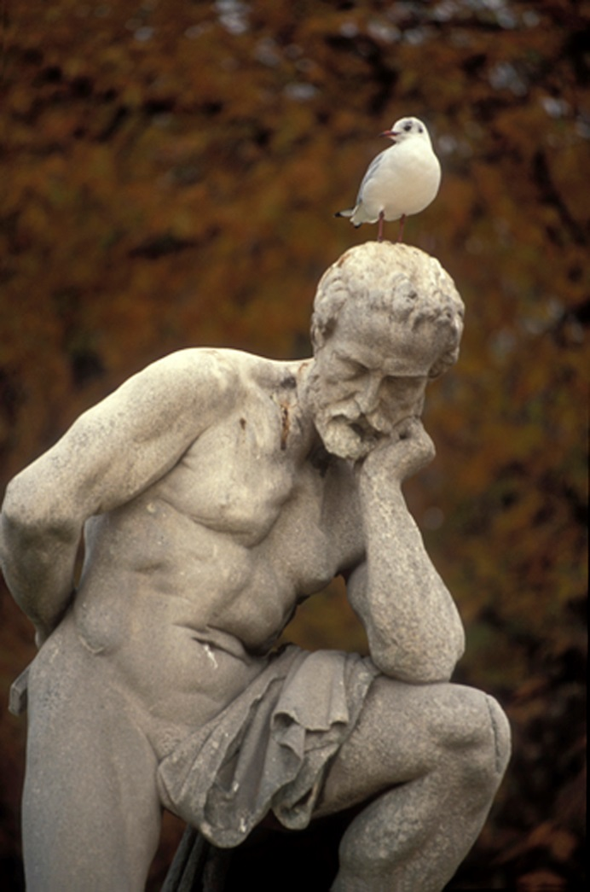
How do you know if the source is reliable?
Notes:
^*#{}#*^
SHOW merlin, merlin.acs, 83, 80
PLAY RestPose
SAY Now we move to the Questions for Analyzing Primary Sources.
SAY These questions are for guidance only.
SAY They are not meant to be answered directly.
SAY They are something for you to think about.
SAY In using these questions to analyze the primary source,
SAY read the introduction to the primary source.
SAY Try and understand who the author is.
SAY What social position, occupation, and political leaning does the author have?
SAY This will give you an idea on the perspective and judgment of the author regarding the event happening.
SAY These questions may help you judge the quality of primary sources.
SLIDE 18= PLAY RestPose

Slide 13
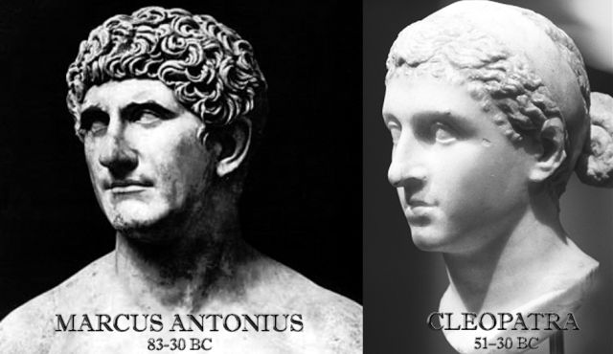
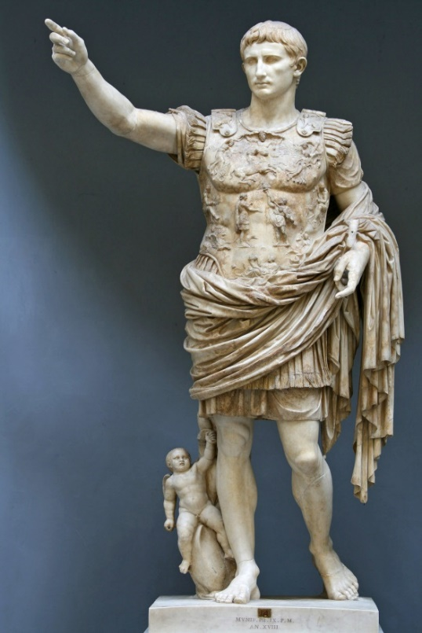
1. Who created the source and why?
Notes:
^*#{}#*^
SHOW merlin, merlin.acs, 83, 80
PLAY RestPose
MOVE 88, 32
SAY The first important question is Who created the source and why?
PLAY Explain
SAY Was it created through a spur-of-the-moment act.
SAY Was it a routine transaction, or a thoughtful, deliberate process?
SAY Who created the source and why, helps you understand the event to which the source applies.
SLIDE 19= PLAY RestPose

Slide 14
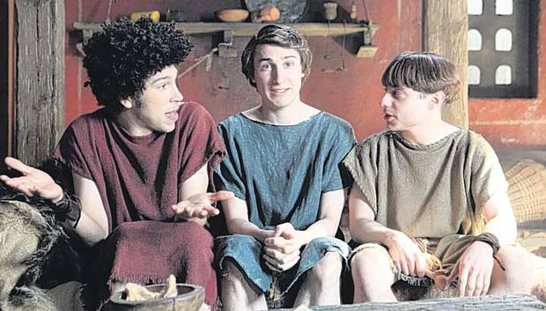
2. Did the author have firsthand knowledge
of the event?
Notes:
^*#{}#*^
SHOW merlin, merlin.acs, 83, 80
PLAY RestPose
SAY Question 2 is, Did the author have firsthand knowledge of the event?
PLAY Explain
SAY Or, did the author report what others saw and heard?
PLAY GestureRight
SAY Here you are making a judgment relative to actual participation in the event.
SAY How tangential was the participants involvement?
SLIDE 20= PLAY RestPose

Slide 15
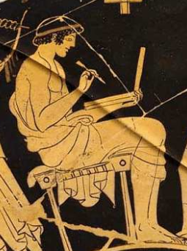
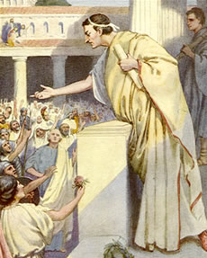
3. Was the author a neutral party?
Were they a source for the event or are they trying to influence the reader?
Notes:
^*#{}#*^
SHOW merlin, merlin.acs, 83, 80
PLAY RestPose
SAY An important third question is, Was the author a neutral party,
PLAY Explain
SAY or did the creator have opinions or interests that might have influenced what was recorded?
PLAY Suggest
SAY Remember to try and get background on the author as to social, political, and economic standing.
SLIDE 21= PLAY RestPose

Slide 16
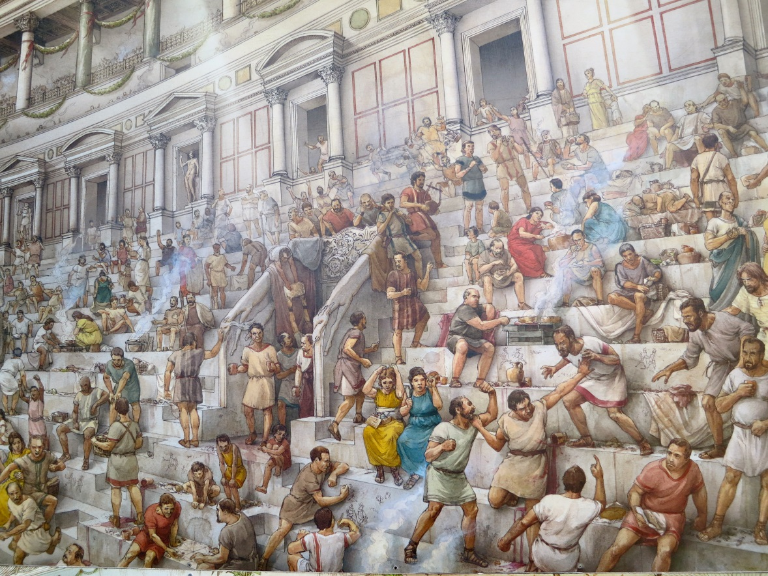
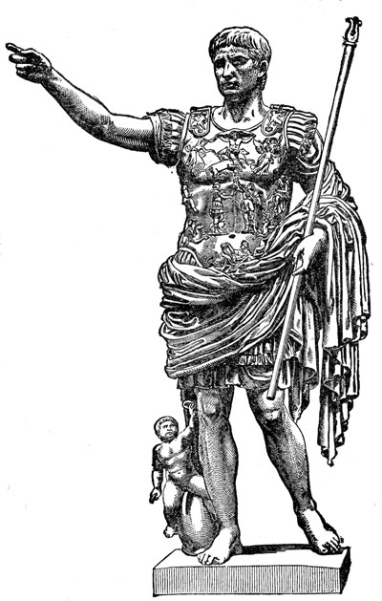
4. Did the author create it for personal use, for one or
more individuals, or for a large audience?
Notes:
^*#{}#*^
SHOW merlin, merlin.acs, 83, 80
PLAY RestPose
SAY The next question to ask concerns how best the information is to presented, and for whom.
PLAY Confused
SAY Did the author produce the source for personal use, for one or more individuals, or for a large audience?
SAY Was the source meant to be public or private?
PLAY Explain
SAY Was the participant in the event being interviewed by the author?
SAY For example, did the participant appear before an investigative committee of some kind?
SAY Maybe before Congress, or testifying in court.
SLIDE 22= PLAY RestPose

Slide 17
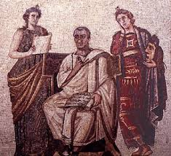
5. Did the author wish to inform or persuade others?
Notes:
^*#{}#*^
SHOW merlin, merlin.acs, 83, 80
PLAY RestPose
SAY The fifth guide question is,
SAY Did the author wish to inform or persuade others?
PLAY Explain
SAY Here, Check the words in the source document.
PLAY RestPose
SAY The words may tell you whether the author was trying to be objective or persuasive.
PLAY Confused
SAY Did the author have reasons to be honest or dishonest?
PLAY Explain
SAY Making a judgment about the truthfulness of the author,
SAY or whether the author was going to gain anything by producing the source.
SAY This may help you determine the degree of bias.
SLIDE 23= PLAY RestPose

Slide 18
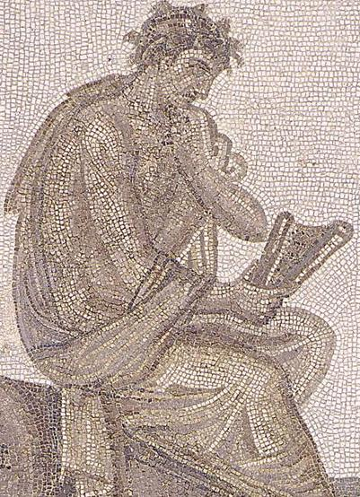
6. How large a lapse of time occurred between the event happening and the information being recorded?
Notes:
^*#{}#*^
SHOW merlin, merlin.acs, 83, 80
PLAY RestPose
PLAY GestureRight
SAY The sixth guide question has several aspects to it.
SAY If the information was recorded during the event,
PLAY Confused
SAY Then the author may be a direct participant in the event.
SAY Was the information recorded immediately after the event, or after some lapse of time?
SAY How large a lapse of time was there?
PLAY Explain
SAY The passing of time has an effect on a persons memory.
SAY Details of the event change with time.
PLAY Confused
SAY May this be possible in this source?
PLAY RestPose
SAY Look into this carefully, is goes to bias.
SLIDE 24= PLAY RestPose

Slide 19

7. What was the significance of the primary source in relation to the event; to our study of history.
Notes:
^*#{}#*^
SHOW merlin, merlin.acs, 83, 80
PLAY RestPose
MOVE 85, 30
SAY This last guide question, gets at the heart of why you are analyzing primary source data.
PLAY Confused
SAY What was the significance of the primary source in relation to the event; to our study of history.
PLAY Explain
SAY Judging from other sources, how important is the source you are analyzing in the overall scheme of history?
SAY Does the source add perspective to the event you are studying.
PLAY RestPose
SAY You should have a better view of what happened in history.
SAY Having a more complete account of events, enables you to understand the continuity of history.
MOVE 83, 80
SAY Here you might want to see if your secondary source, the textbook, contradicts or corroborates the primary source.
SLIDE 25= SAY So, what have we covered here?

Slide 20
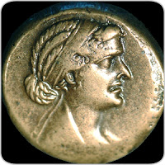
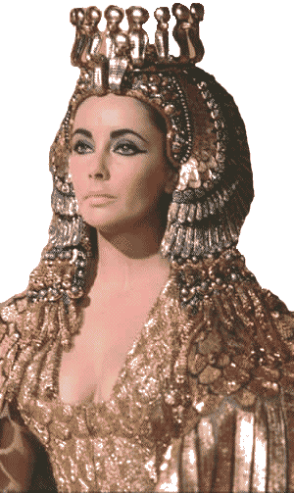
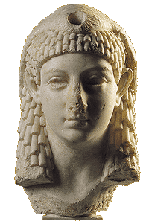

PRIMARY or SECONDARY?
For each of the following indicate if it is a PRIMARY SOURCE
or a
SECONDARY SOURCE

Slide 21
A letter written by Julius Caesar to Cleopatra
Dear Cleo,
Join me in Rome and I will wine and dine you as only a Latin can .
We can see the races at the Circus Maximus.
Rome is lovely at this time of year.
As a fellow god you must see your world.
Love, Julius

Slide 22
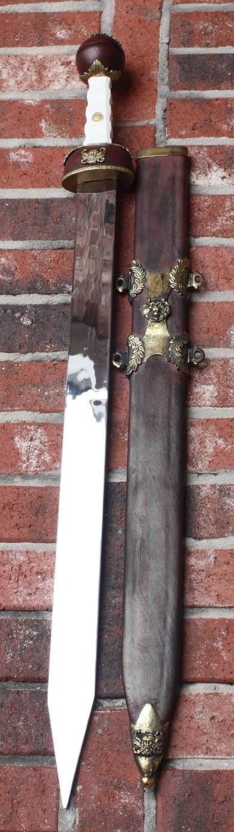
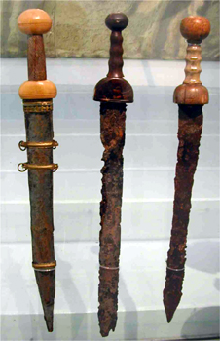
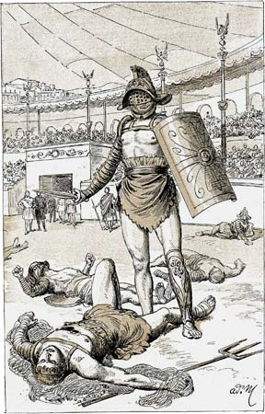
Gladiator swords found in a basement of the Colosseum

Slide 23
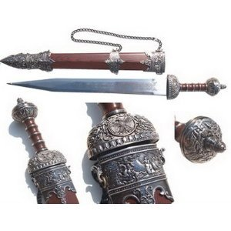
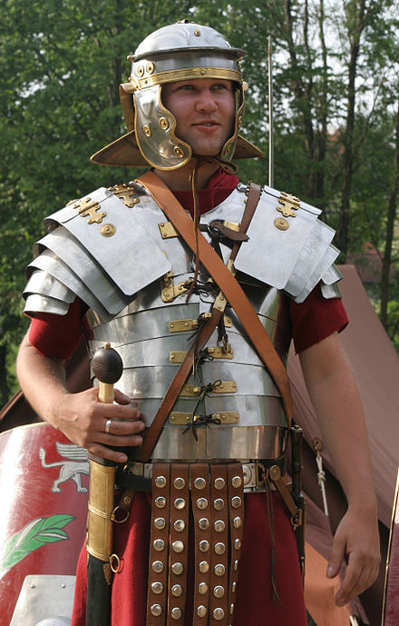
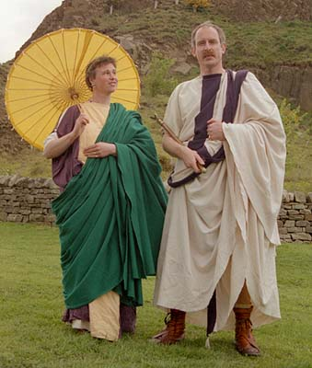
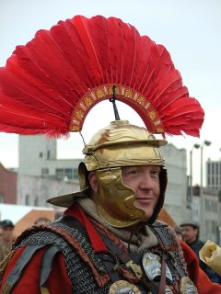
Replica weapons and clothing

Slide 24
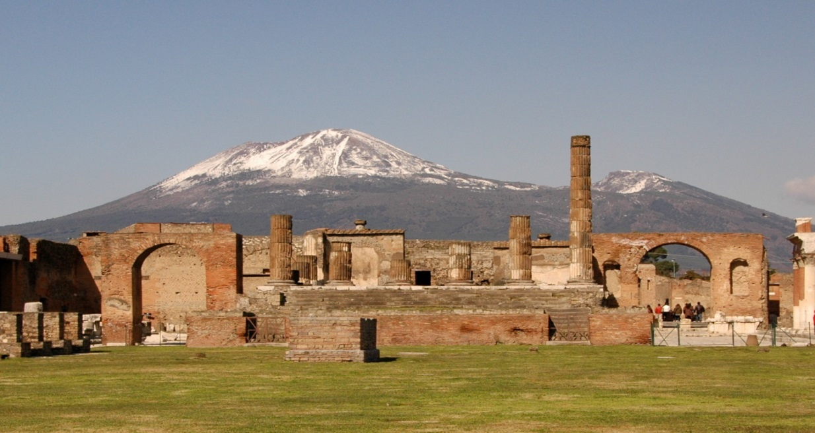
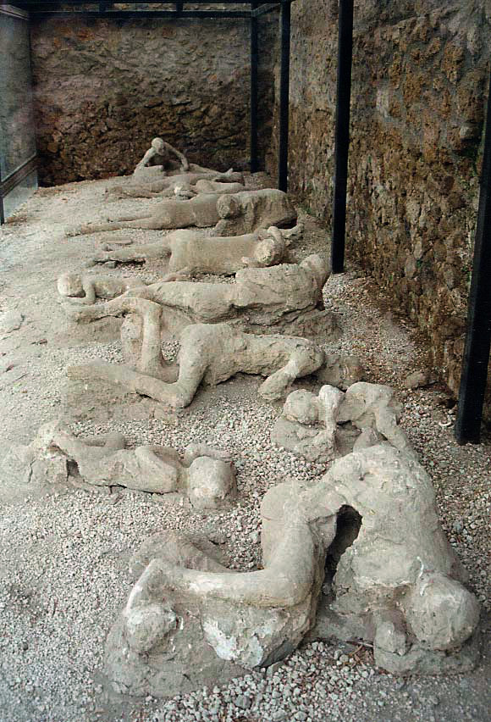
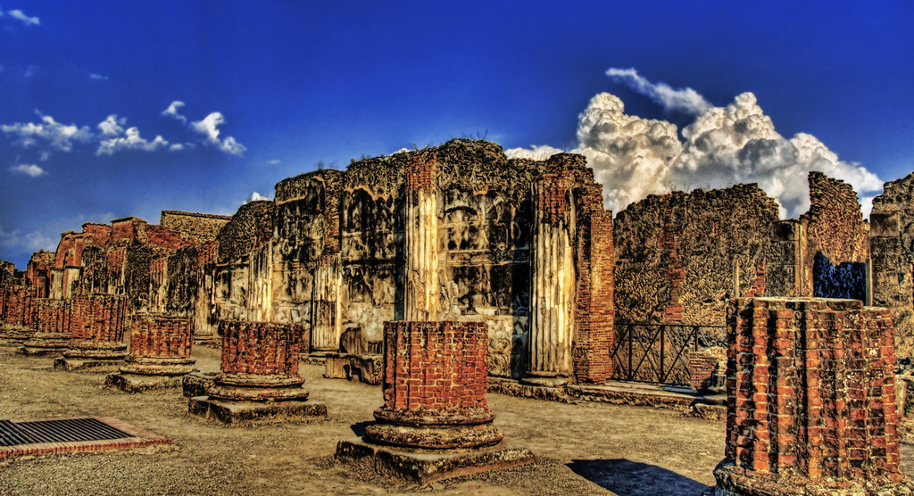
The ruins of Pompeii and Herculaneum

Slide 25
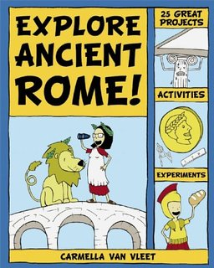
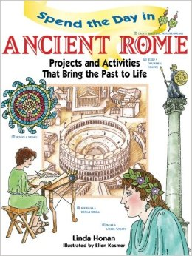
A high school textbook on
Ancient Rome

Slide 26
A newspaper article discussing Pompeii
The Roman Times
Pumice pours over Pompeii
26th August, 1979 A.D.
Written by Maximus Nortius
One thousand years ago today, the city of Pompeii was wiped out after the volcano, Mount Vesuvius, erupted covering the city in millions of tonnes of volcanic ash and debris. It is estimated that over 2000 people were killed in the catastrophe. Those who escaped lost everything and have been forced to start a new life in other parts of Italy.

Slide 27
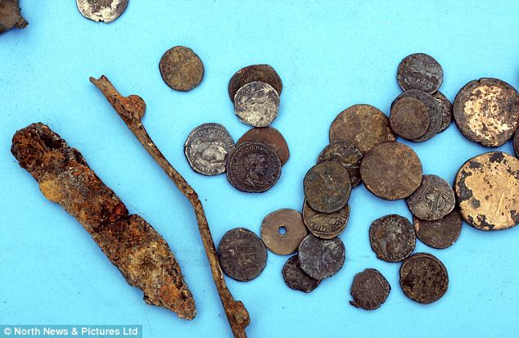
Roman coins found in an English farmers field

Slide 28
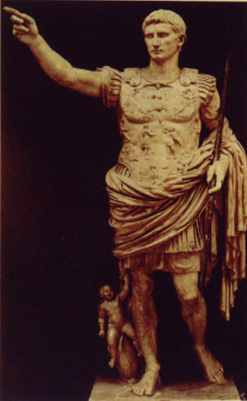
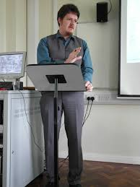
A lecture by a university professor about Caesar Augustus

Slide 29
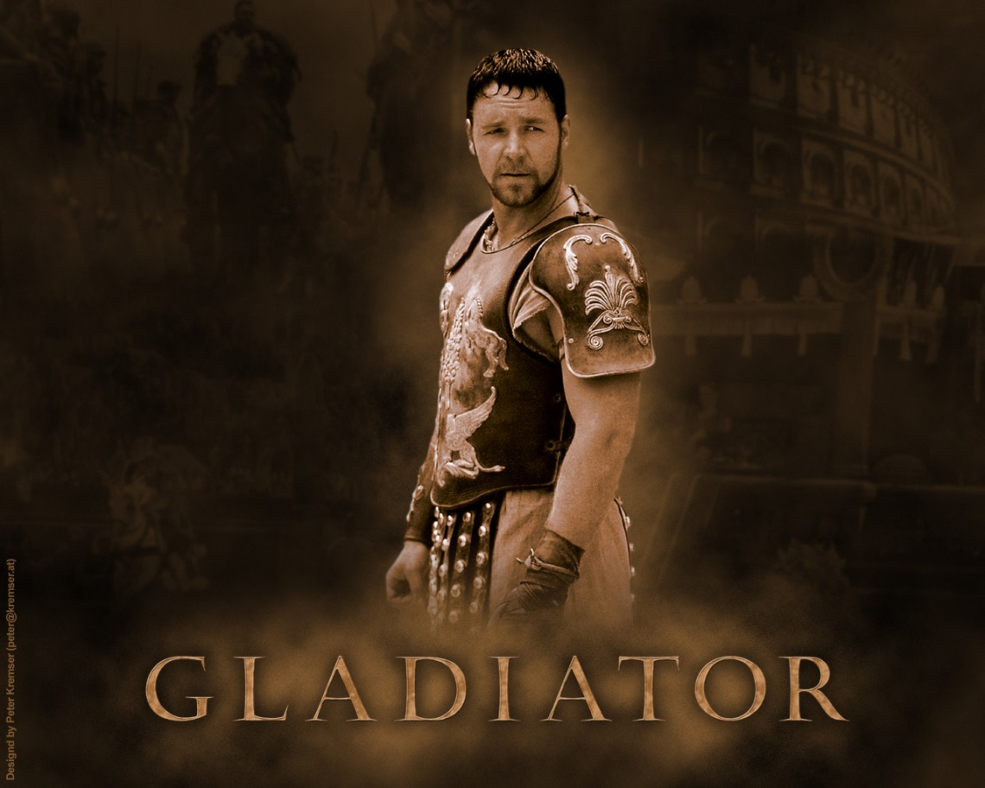
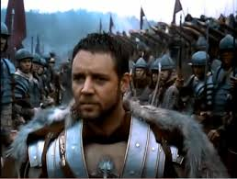
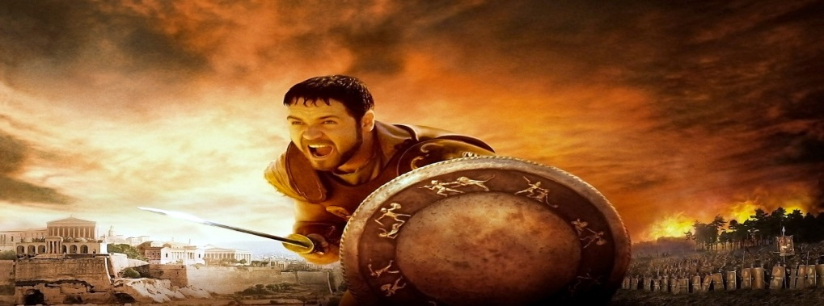
The Russell Crow movie Gladiator

Slide 30
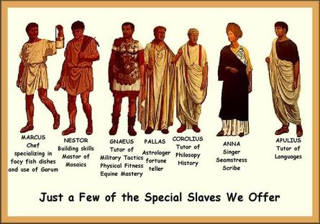
A television documentary about slaves in Ancient Rome

Slide 31
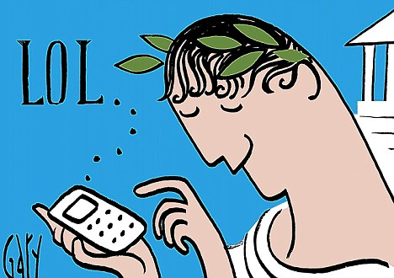
Summary
In your own words explain the difference between PRIMARY and SECONDARY sources.

Slide 32
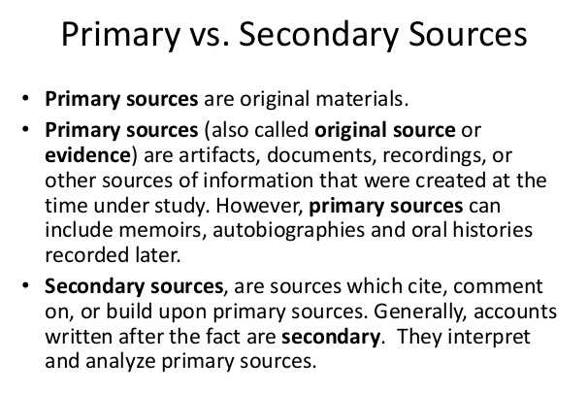

Slide 33


